Slide 1
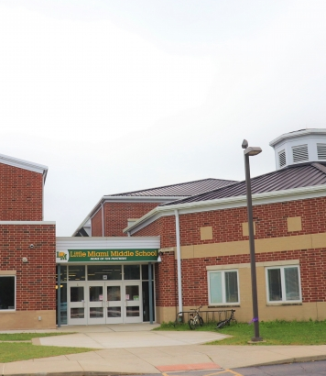

Welcome to 6th Grade!
Little Miami Middle School

Slide 2
Little Miami Middle School
Mrs. Fox – 6th Grade Counselor
Mrs. Copeland - 7th Grade Counselor
Mrs. Wall – 8th Grade Counselor
Mrs. Singleton – Mental Health Consultant
Mr. Cherry – Principal
Mr. Showers – Assistant Principal
Mrs. Parker – Assistant Principal

Slide 3
SAMPLE
6th grade Schedule
ETEH | 7:20 - 8:15
ELA | 8:15-9:35
Math | 9:35-10:15
LUNCH | 10:15-10:45
Math | 10:45-11:35
Recess | 11:40-11:55
Specials | 12:00-12:47
Science/Social Studies | 12:50-2:00
Student drop off begins at 6:45 AM
Car Riders and bus dismissal at 2:00 p.m.
6th Grade will have specific times for lunch, recess, and specials – the remainder of the day will be spent in their teams and core classes
6th grade classes are in the new wing, while 7th and 8th grade classes are in a separate part of the building

Slide 4
What is ETEH?
Extra Time/Extra Help:
This is a time for enrichment or intervention based upon the need of the student.
Students will be assigned an ETEH teacher for their homeroom class.
Students will be able to visit other teachers during this time for additional help.
6th Grade students have band and choir during this time.

Slide 5
Band and Choir
These classes are for a grade and meet during ETEH.
Instrument options: clarinet, flute, trombone, trumpet, and bells/percussion
Choir
If you are interested in music for your student, please contact LMES or LMMS for a music interest form

Slide 6
Specials/
Electives
Physical Education
Art
STEM
Choir – during ETEH (optional)
Band - during ETEH (optional)

Slide 7
Lunch
We allow students to choose seats at the beginning of the year but ask them to keep those seats unless they ask to move.
6th grade students eat lunch based on their teams during one of these two times
  Lunch 1 –10:10-10:40
  Lunch 2 – 10:25-10:55
Once you choose a seat- you must stay there unless you have permission to move
Make good choices! Technology is NOT permitted during lunch (including laptops).

Slide 8
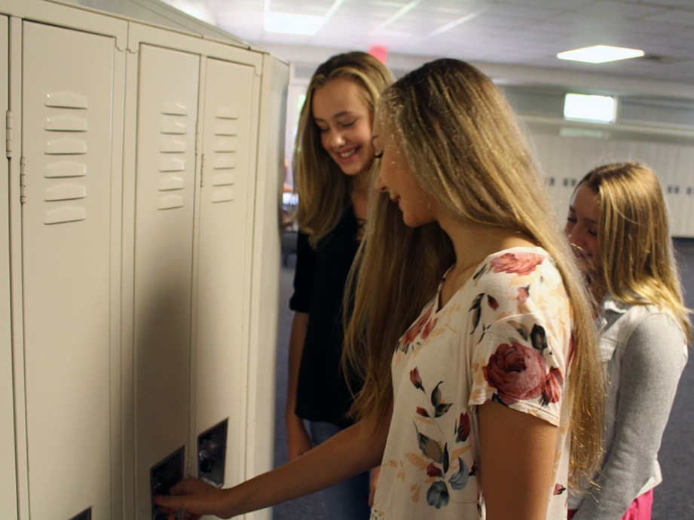
LOCKERS
Students will be assigned a lock and a locker.
Students will be expected to keep the locker always LOCKED.
Students should keep their possessions in their own locker.
Backpacks – Students must use a clear backpack if they're going to carry it between classes.

Slide 9
Afterschool Enrichment Program
The After-School Enrichment Program (A.S.E.P.) provides fun after school activities for students.
Classes are 6-week sessions typically in the Fall, Winter and Spring
Classes will meet one day per week.
Students who sign up for a class will be asked to pay a fee based on supplies and expenses.
Class offerings are based on student interest and instructor availability.
Classes include yoga, anime, Magic the Gathering, Book Club, art club, and more!

Slide 10

Expectations
GOLDEN RULE: Treat others as you want to be treated.
Make good choices!
Be Safe
Be Responsible
Be Respectful
Be a Problem Solver

Slide 11
Student laptops
Students will be provided a district-issued laptop to use for schoolwork and homework.
Students will be responsible for bringing the computer to and from school and for keeping it charged each day.
A device agreement will be sent out to families prior to the end of this school year.
Teacher and staff will use Schoology as the main communication method for parents and families.

Slide 12
Cell Phones
When at school, cell phones should be turned off and stored in locker.
Taking photos/videos at school is prohibited
Depending on the severity of the cell phone offense consequences may range from a warning to confiscating the phone until a parent can pick it up.
Students are not permitted to use cell phones during the school day.

Slide 13

Social Media In Middle School
If your student has a device, they are on social media.
Most of our complaints about harassment and bullying have a social media component.
Students are more likely to threaten, use inappropriate language or escalate a situation from behind a screen.
Issues that begin on social media but continue into the school day can have school-based consequences.
Again, cell phones are not permitted to be on/used during the school day, so students should not be on social media during school hours.

Slide 14
Important Dates
May 21st: Bump Up Day – 5th grade students visit LMMS during the school day.
August 2024: Schedules and homerooms released to Progress Book
  Communication through letters, School Messenger, and social media
  Also, possible device pick-up prior to the start of the school year
August: Open House August 13th 5:00-7:30
August 15th: first day of 6th grade at LMMS

Slide 15

It’s a GREAT day to be a PANTHER!!!

Slide 16
Gifted Services
Little Miami Local School District supports gifted students by incorporating challenging educational programs for identified students that vary in depth, breadth, complexity, pace or otherwise provide above grade-level content.

Slide 17
Gifted Language Arts Expectations
Nightly homework varies dependent on what is finished in class that day.
Every other week, students can expect an Article of the Week assignment that is given on Mondays and due on Fridays.
Students are expected to read for 20-30 minutes a night
1-2 Book Talk projects per quarter

Slide 18
Gifted Math Expectations
Students will have nightly homework in Math
Students will have a weekly review sheet
Students will complete projects throughout the quarter that challenging and enrich problem-solving skills.
The class will move at a more accelerated pace and cover some 7th grade concepts.

